Slide 1

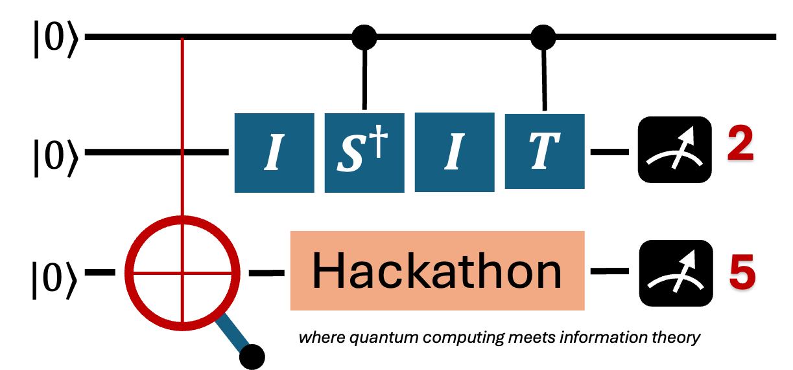
Bell State Builders
ECG Autoencoder & Classifier

Slide 2
ECG data ("heart rate monitors") frequently require human resources to assess. Can this task be computerized?
We propose a QML approach to "learn" what good and bad ECG data is.
We train and apply a QAE to the PCB-XL ECG dataset, then use a QSVM approach to train a circuit for classification.
Tech stack: qiskit, torch, sklearn
Transforming data into a quantum form adds an extra point of failure.
But we can work to make the best autoencoder possible and test it against the classical baseline before moving on.

Slide 3
Demo Time

Slide 4
Applying ML techniques to the medical field can save lives.
Our project can detect early signs of a heart attack.
Our model achieves 76% accuracy which shows promise on a simulator.
It will improve with time and could be a viable model for market.
We will continue testing our model and improving on it, specifically by moving on to real hardware.

Slide 5
Team Members (US Based Team):
Claudia Friedsam - Postdoctoral Researcher @ Epitome Labs
claudia.friedsam@gmail.com
Divyam Kamboj - Masters Student @ University of Michigan
divyam.kamboj11@gmail.com
Michael Papadopoulos - PhD Student @ Lehigh University
micpap25@gmail.com

